Slide 1
Amazon sale
By: Mahmoud kandeel

Slide 2
Steps:
EDA
Data Cleaning
Visualization
Model
Key Findings & Insights
Contribution
Recommendations

Slide 3
EDA:
Data structure:
Our data consists of 128975 rows and 23 columns
Data types:
All columns are categorical except Qty & Amount & ship_postal_code are numeric and B2B is bool
Null Values:
- Currency and Amount columns (MNAR)
- Ship_City, Ship_State, Ship_postal_code and Ship_Country (MNAR)
- Courier Status rows are null when fulfilled is easy ship (MAR)
- Courier Status rows are null when Status is cancelled (MAR)
- fulfilled-by rows are null when Fulfilment is Amazon (MAR)
Duplicates:
There are 6 duplicates
Statistical Analysis:
Data is not normal distributed
Data is biased
There is outliers

Slide 4
Data Cleaning:
Feature Extraction:
- We extracted num of offers used in each order from promotion_ids column
- Extract month, day and day_name from Date column
Handling missing values:
- Removed promotion_ids as it had 38% of his values nulls.
Note that: Next two assumption need decision from client
- All merchant has value easy ship in fulfilled_by so I assumed that null is value verses easy ship which describe amazon fulfilment
- Assumed all null values in unnamed 22: column are True
- Removed null rows from currency and amount as they did not exceed 6% from total data
- Handle missing data in courier status from information in status
Data Type Conversion:
- Convert Date column from object to date time
- Convert ship_postal_code from integar to object

Slide 5
Detect Outliers:
- We used IQR instead of z_score as we assumed data is not normaly distributed
- We decided to let outliers as they are true value not noise
Duplicates:
- We removed them
Merge values:
- We merged values in ship-state, courier status and status to decrease dimension and avoid biased data

Slide 6
Visualization
Present useful trends and graphs

Slide 7
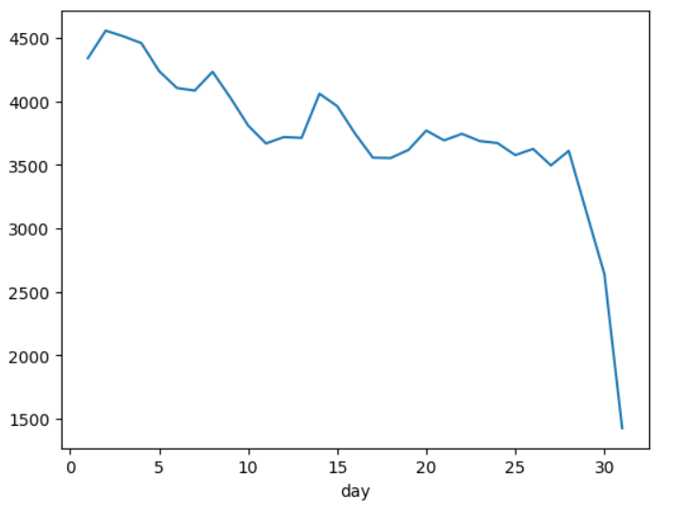
[ Note that we used Streamlite to build the dashboard as our work were done in Kaggle ]
Trend of count orders and day:
- People spend a lot at the beginning of month like us in Egypt.

Slide 8
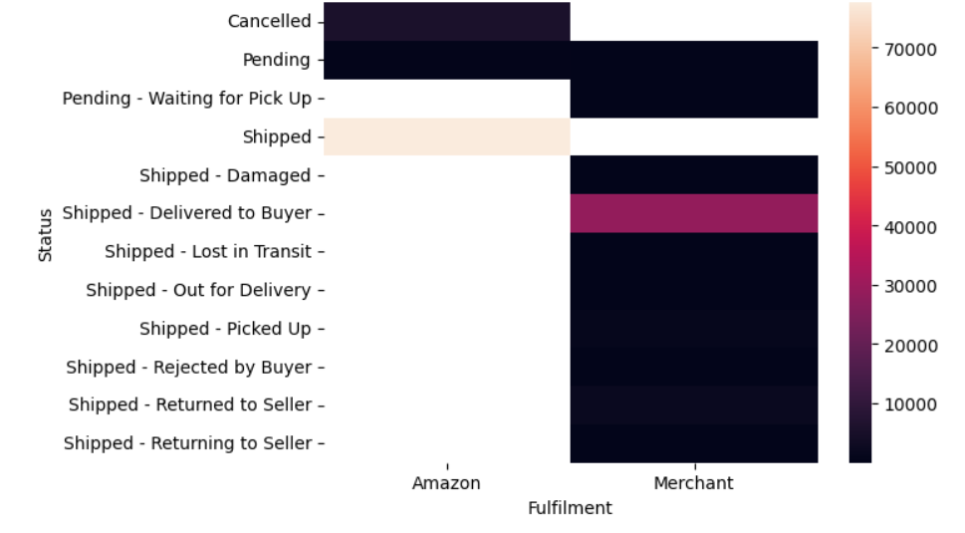
- All problems in shipment when the fulfilment is merchant

Slide 9
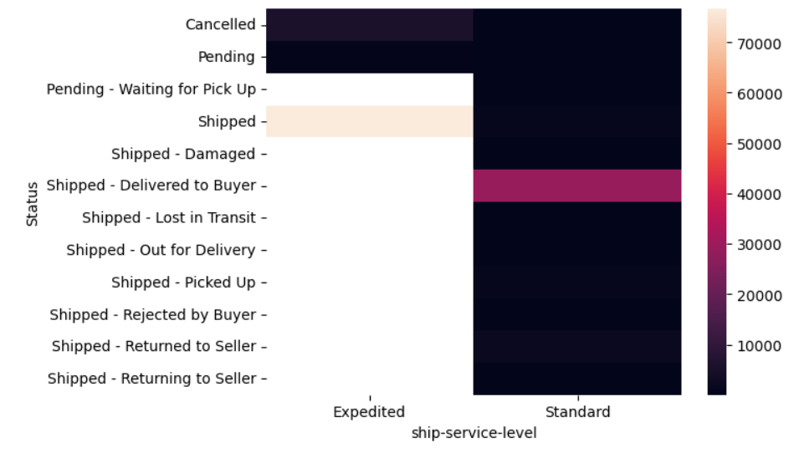
- There is no interest in standard service or there is some thing wrong in inventory

Slide 10
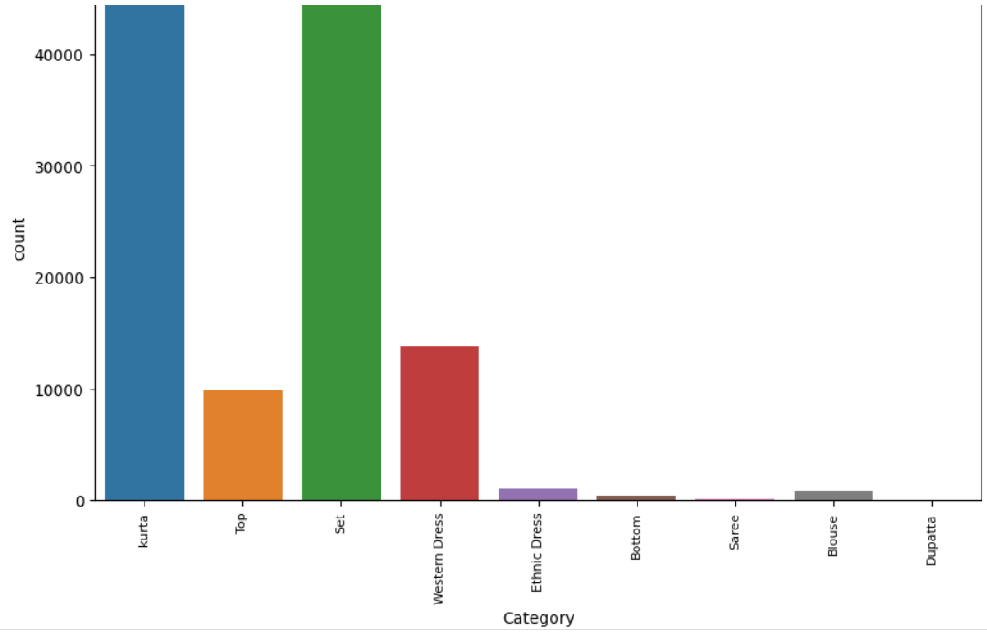
- Set and kurta are the most wanted categories

Slide 11
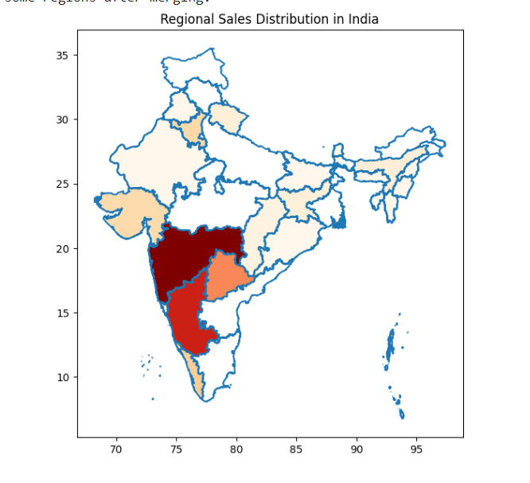
- Maharashtra state has the highest amount spend

Slide 12
Models:
We construct two different models with grid search with K_fold 5 to optimize

Slide 13
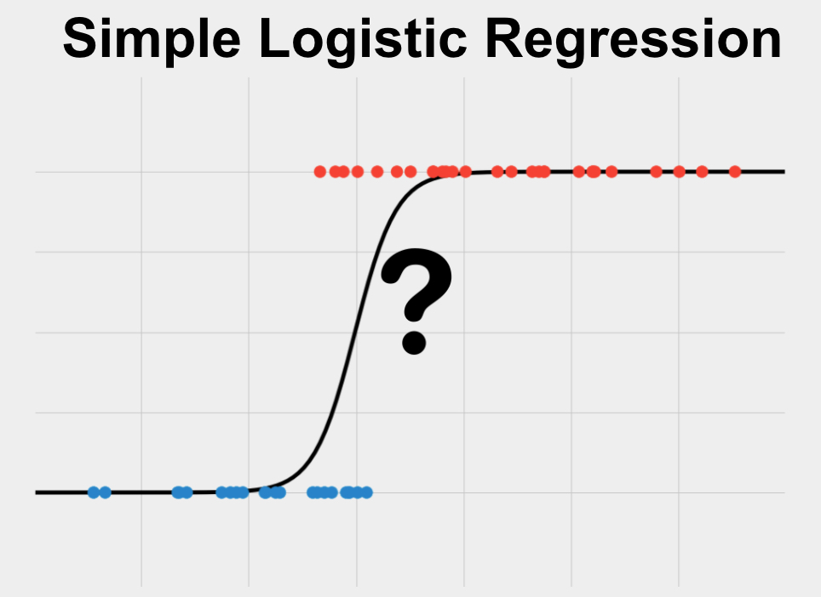
Logistic regression:
Parameters:
Regularization parameter [0.1,1.0]
penalty norm [L1,L2]

Slide 14
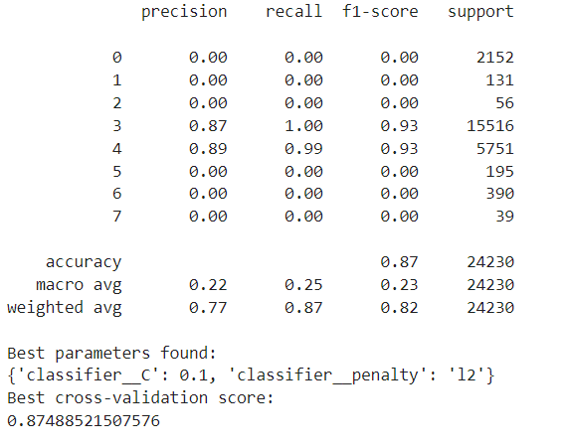
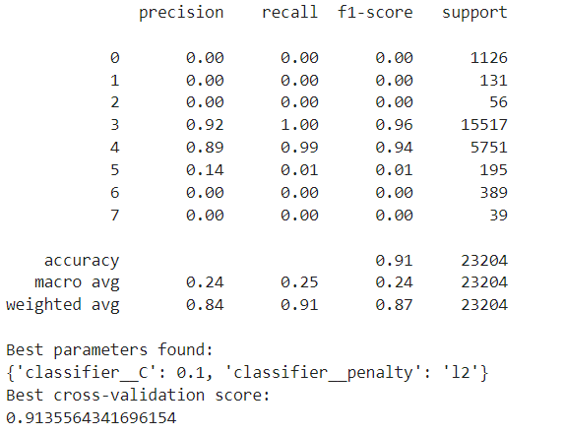
We Build two models with different preprocessing and feature selection

Slide 15
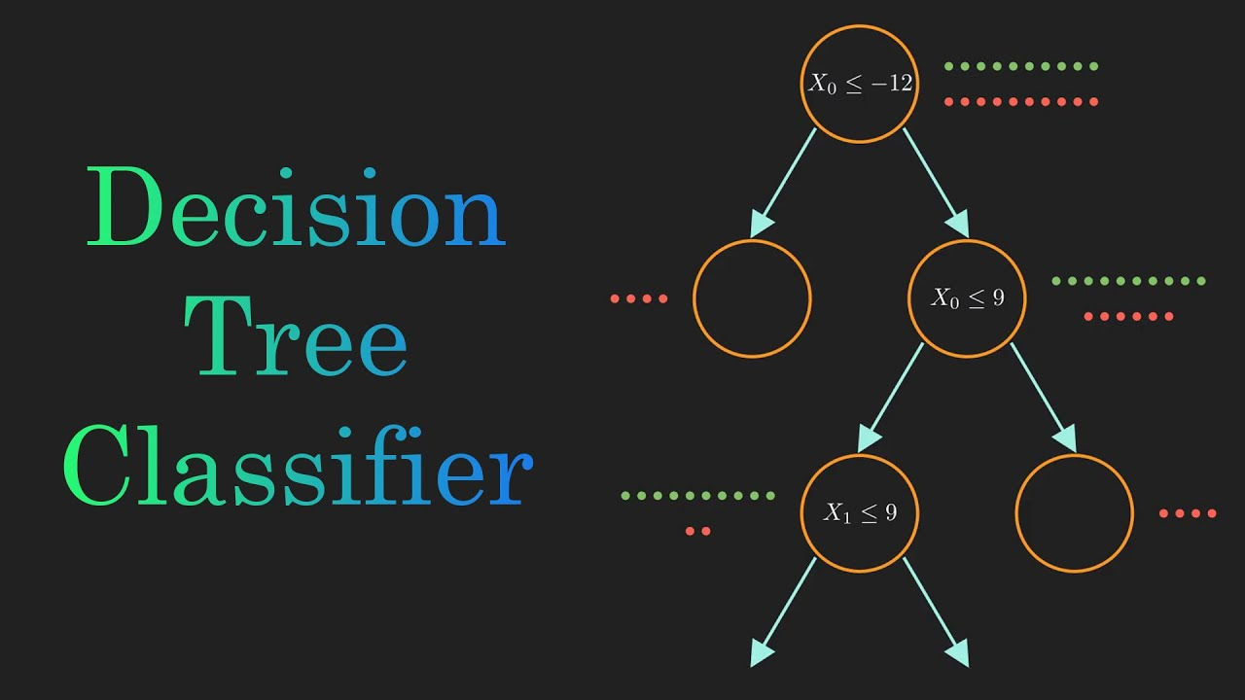
Decision Tree Classifier
Parameters:
- [3, 5, 10, None], # Maximum depth of the tree
- [2, 5, 10], # Minimum number of samples required to split an internal node
- [1, 2, 4], # Minimum number of samples required to be at a leaf node

Slide 16
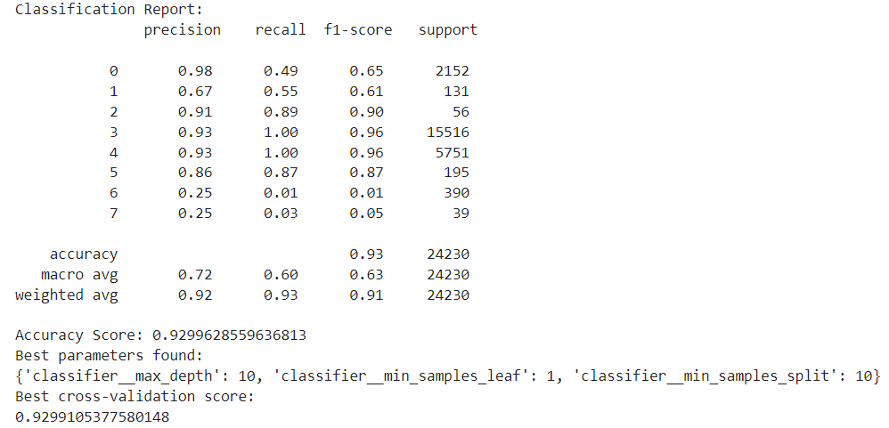
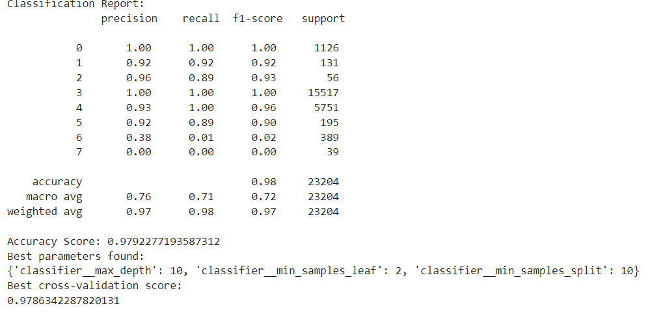
We Build two models with different preprocessing and feature selection

Slide 17
Contribution:
We build a model to early predict for status
If prediction is cancelled or pending we can create offers so order can done
If prediction is problem after shipping so we can avoid this problem
All of this aims to increase number of orders and income

Slide 18
Insights:
The most two items has been sold are Set and kurta
Items Set and Kurta have the heights number of offers
3) Maharashtra state is the highest income
4) All problem when the merchant is the shipper
5) Inventory maybe has problem as all problems are in standard

Slide 19
Recommendation:
We can increase number of offers on the other items
We can have new inventory in Maharashtra to optimize shipping cost
We can make shipping free in states where income is low
We need to send supervisor to follow the shipment process with merchant
And also someone to check the process of standard shipment
We can create offers at the end of the month

